Slide 1
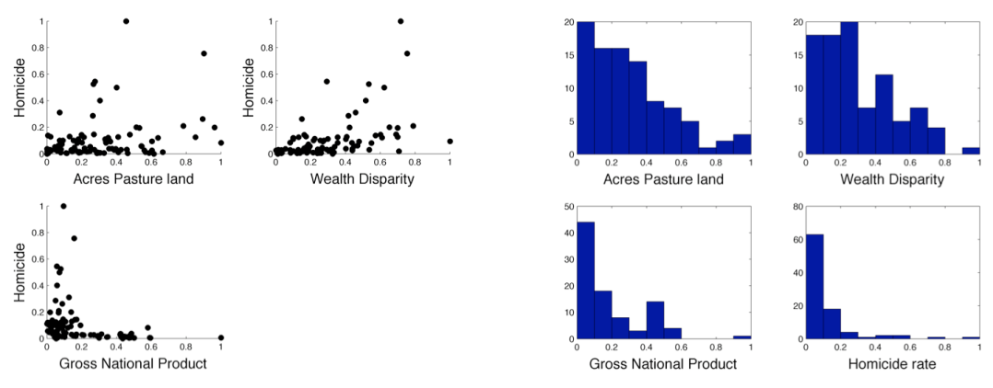

Slide 2
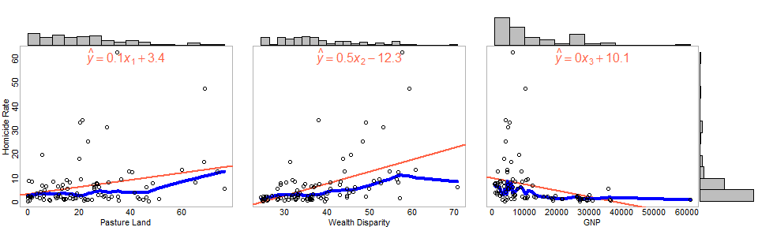

Slide 3
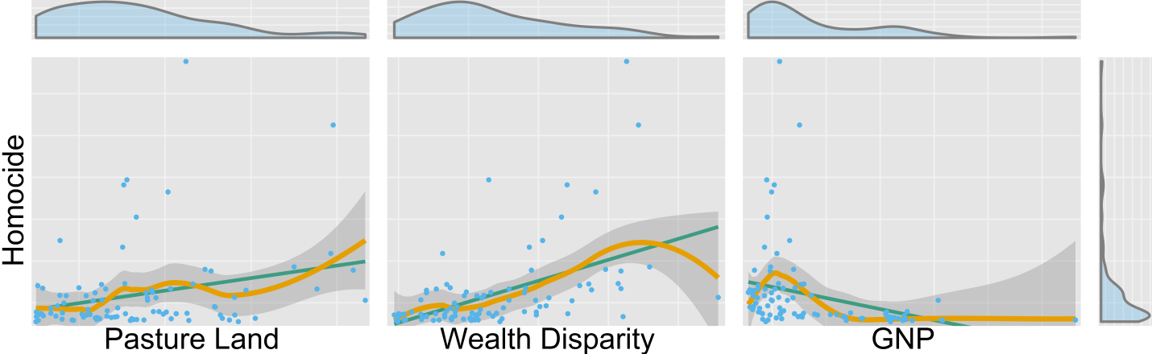
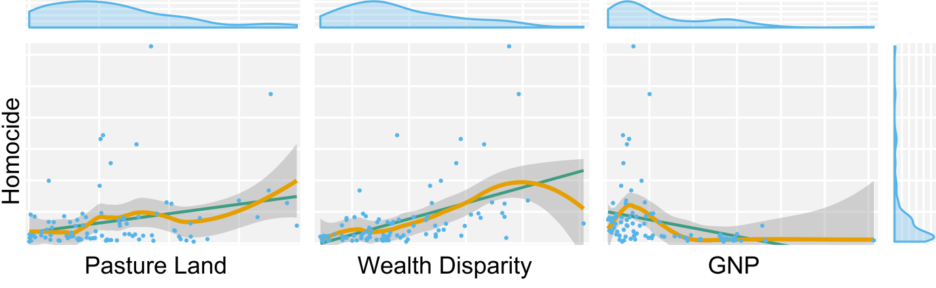

Slide 4
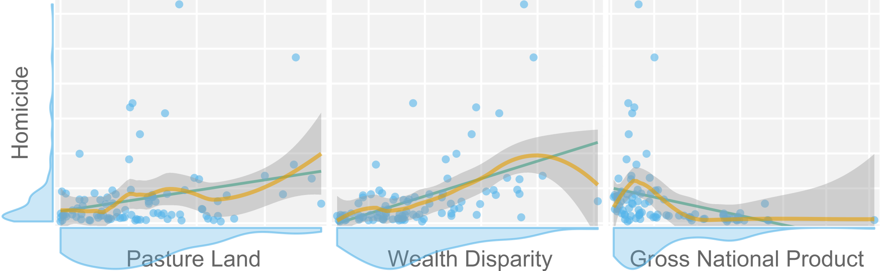
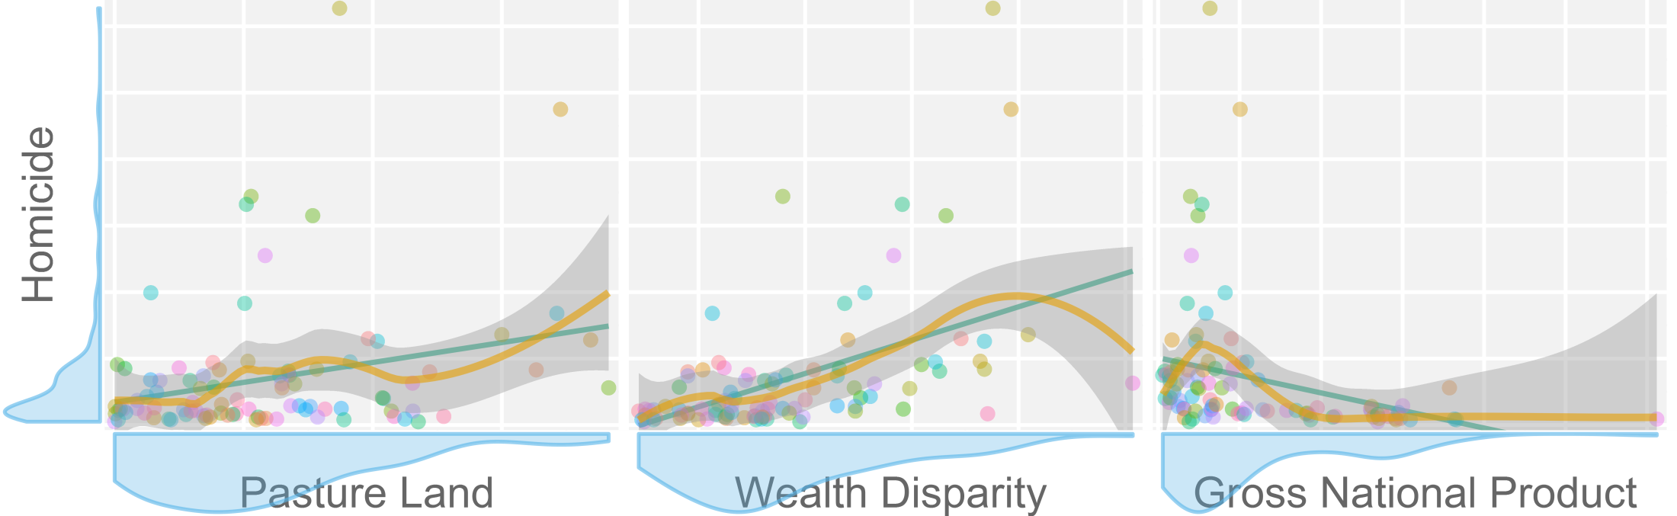
--or--

Slide 6
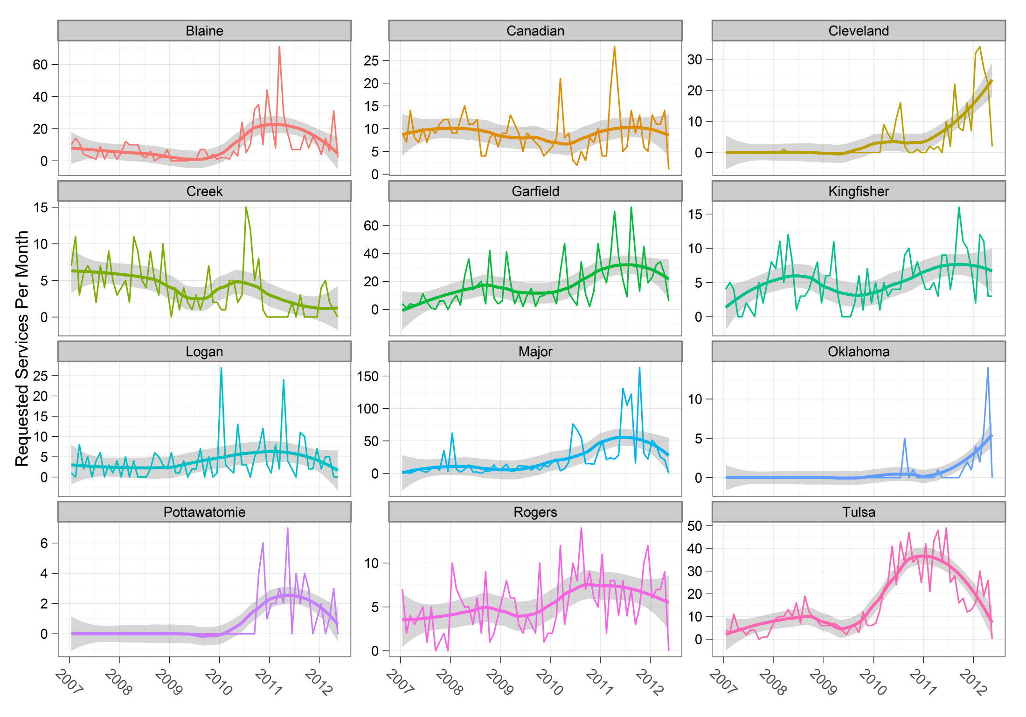

Slide 8
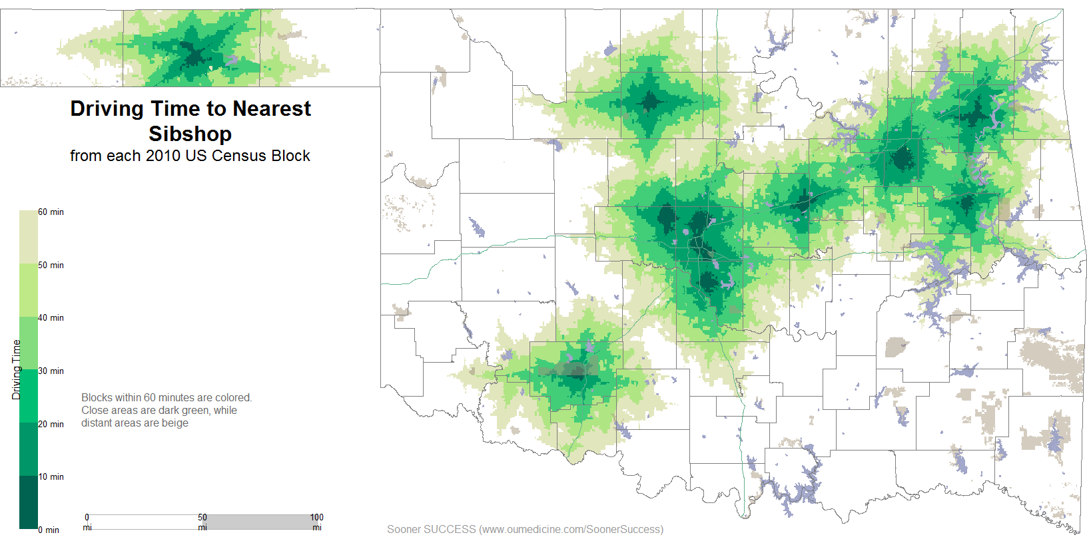

Slide 9
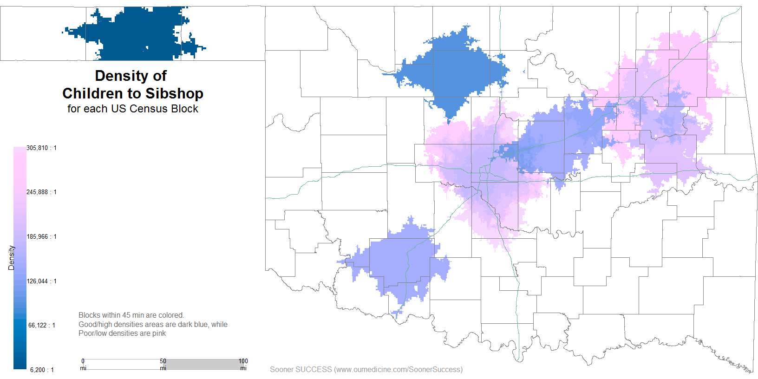

Slide 10
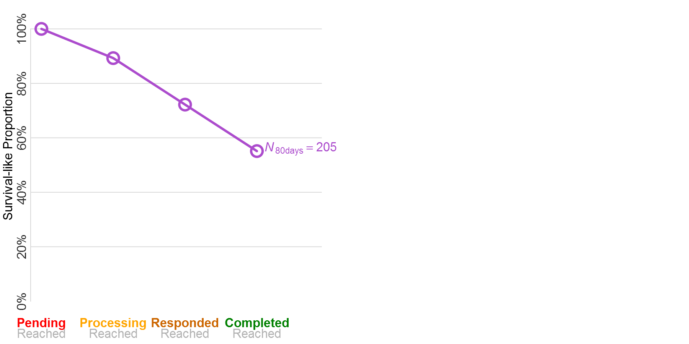

Slide 11
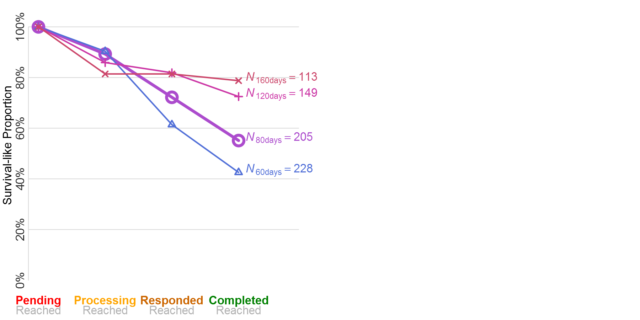

Slide 12
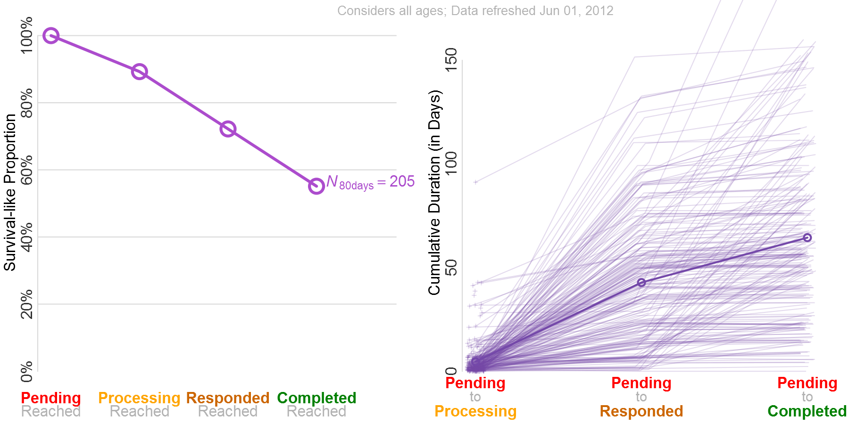

Slide 13
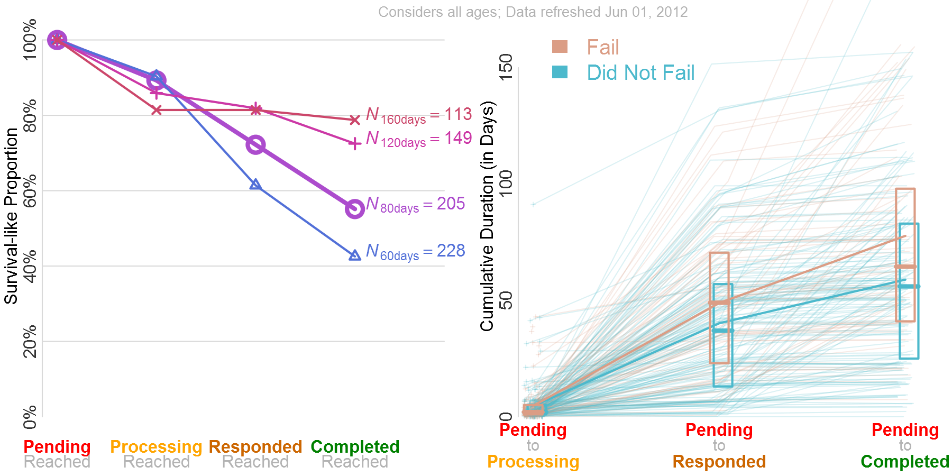

Slide 14
When it’s easy to plot only selected components, it’s easy to produce a sequence of an evolving plot.
It starts simple, and gradually builds complexity to describe a richer picture.
Therefore presentations to non-statisticians are much easier.

Slide 17
When it’s easy to quickly plot the specific aspects of hidden data patterns …you’re more likely to look, and … you’re more likely to gain new insight.

Slide 21
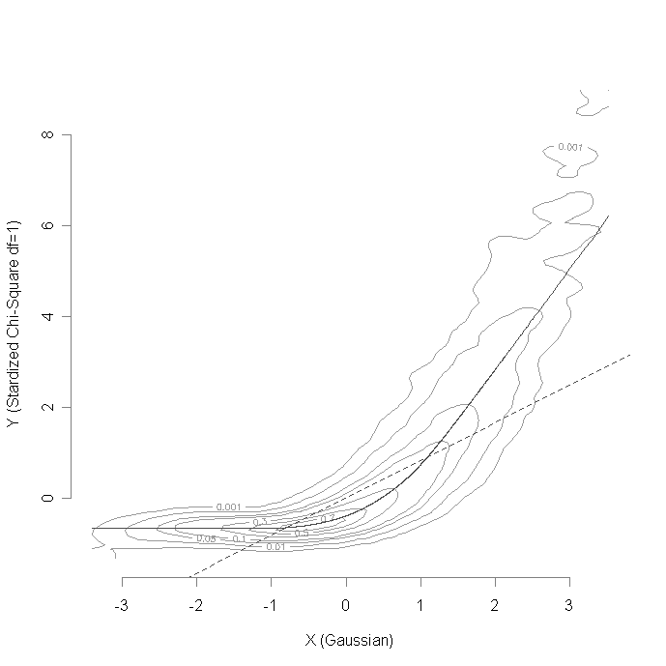
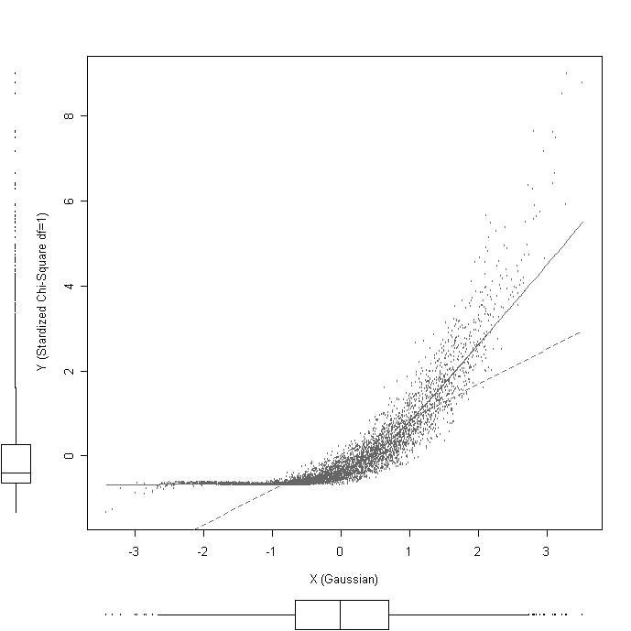
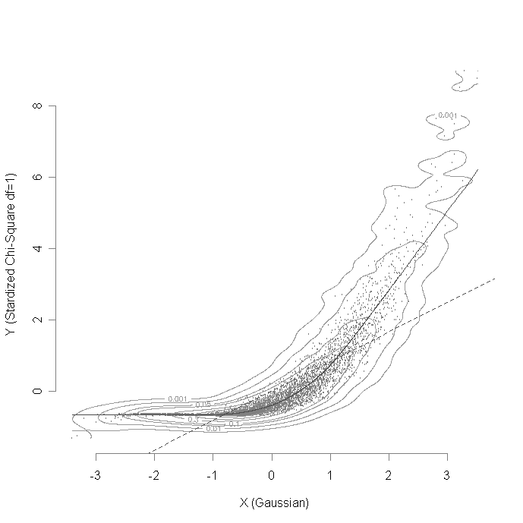
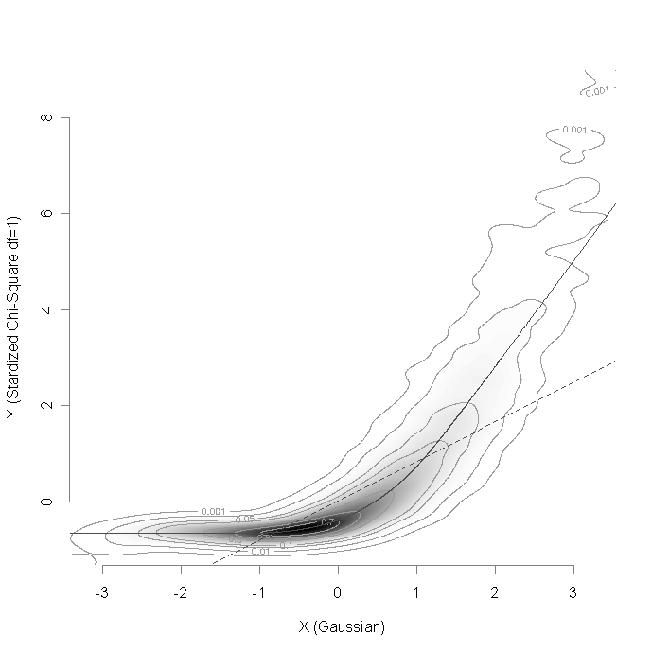
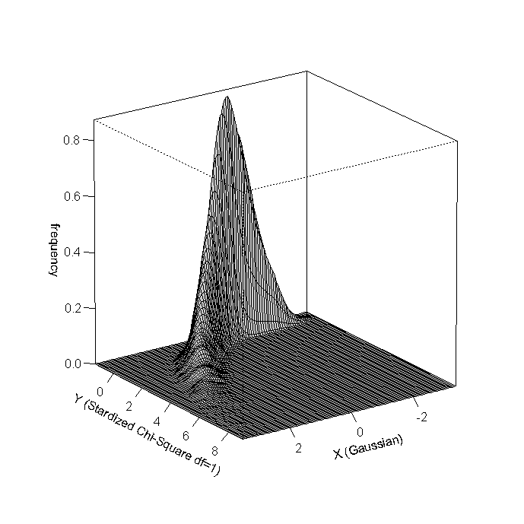
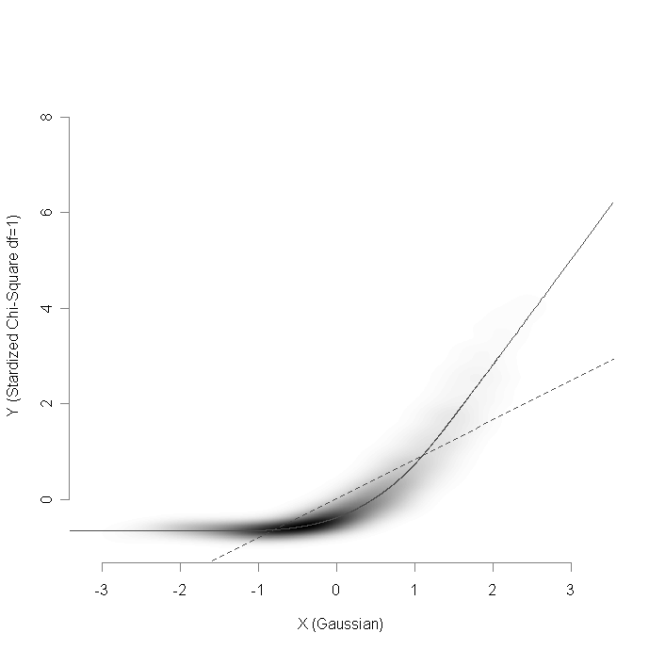

Slide 25
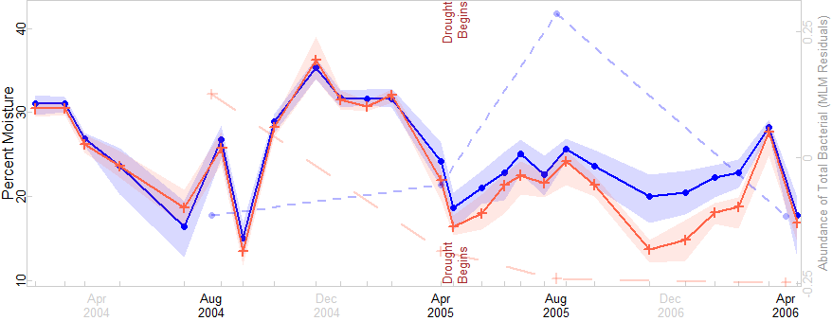

Slide 26
Very few of these graphs will you find as an option in existing in a portfolio of templates to choose from.

Slide 27
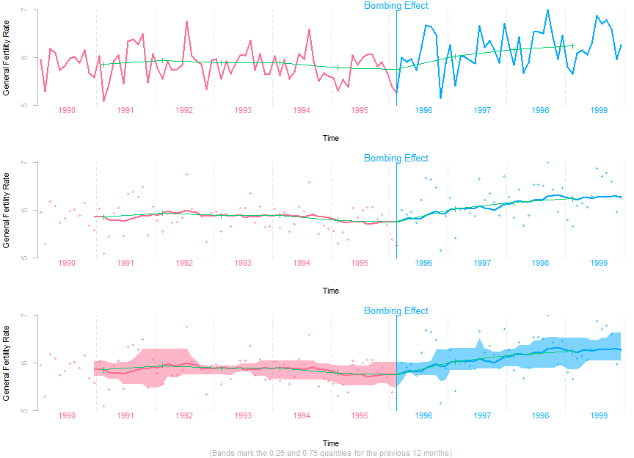

Slide 28
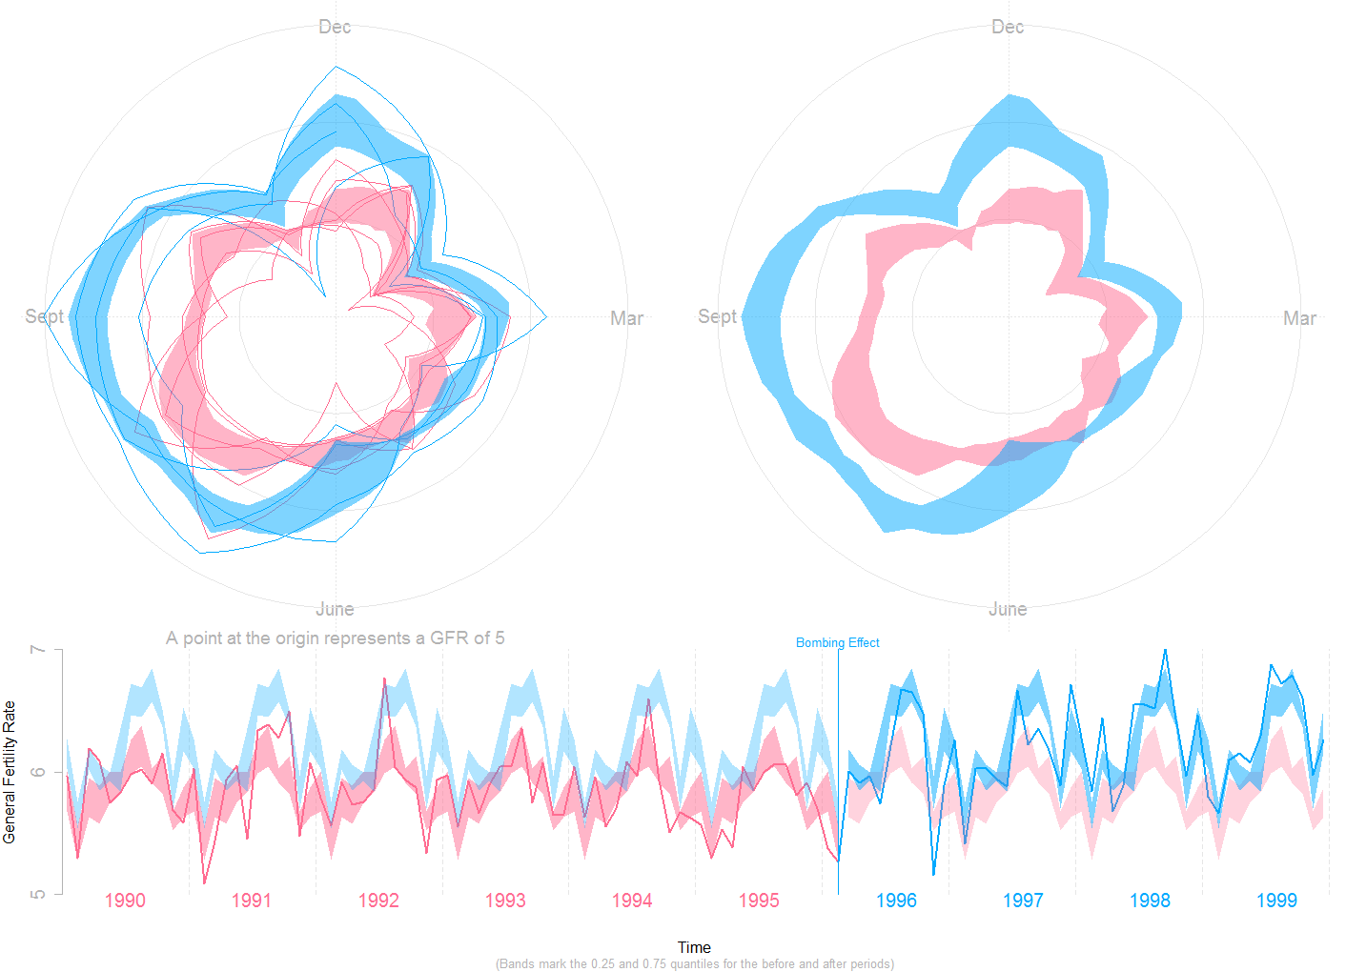

Slide 31
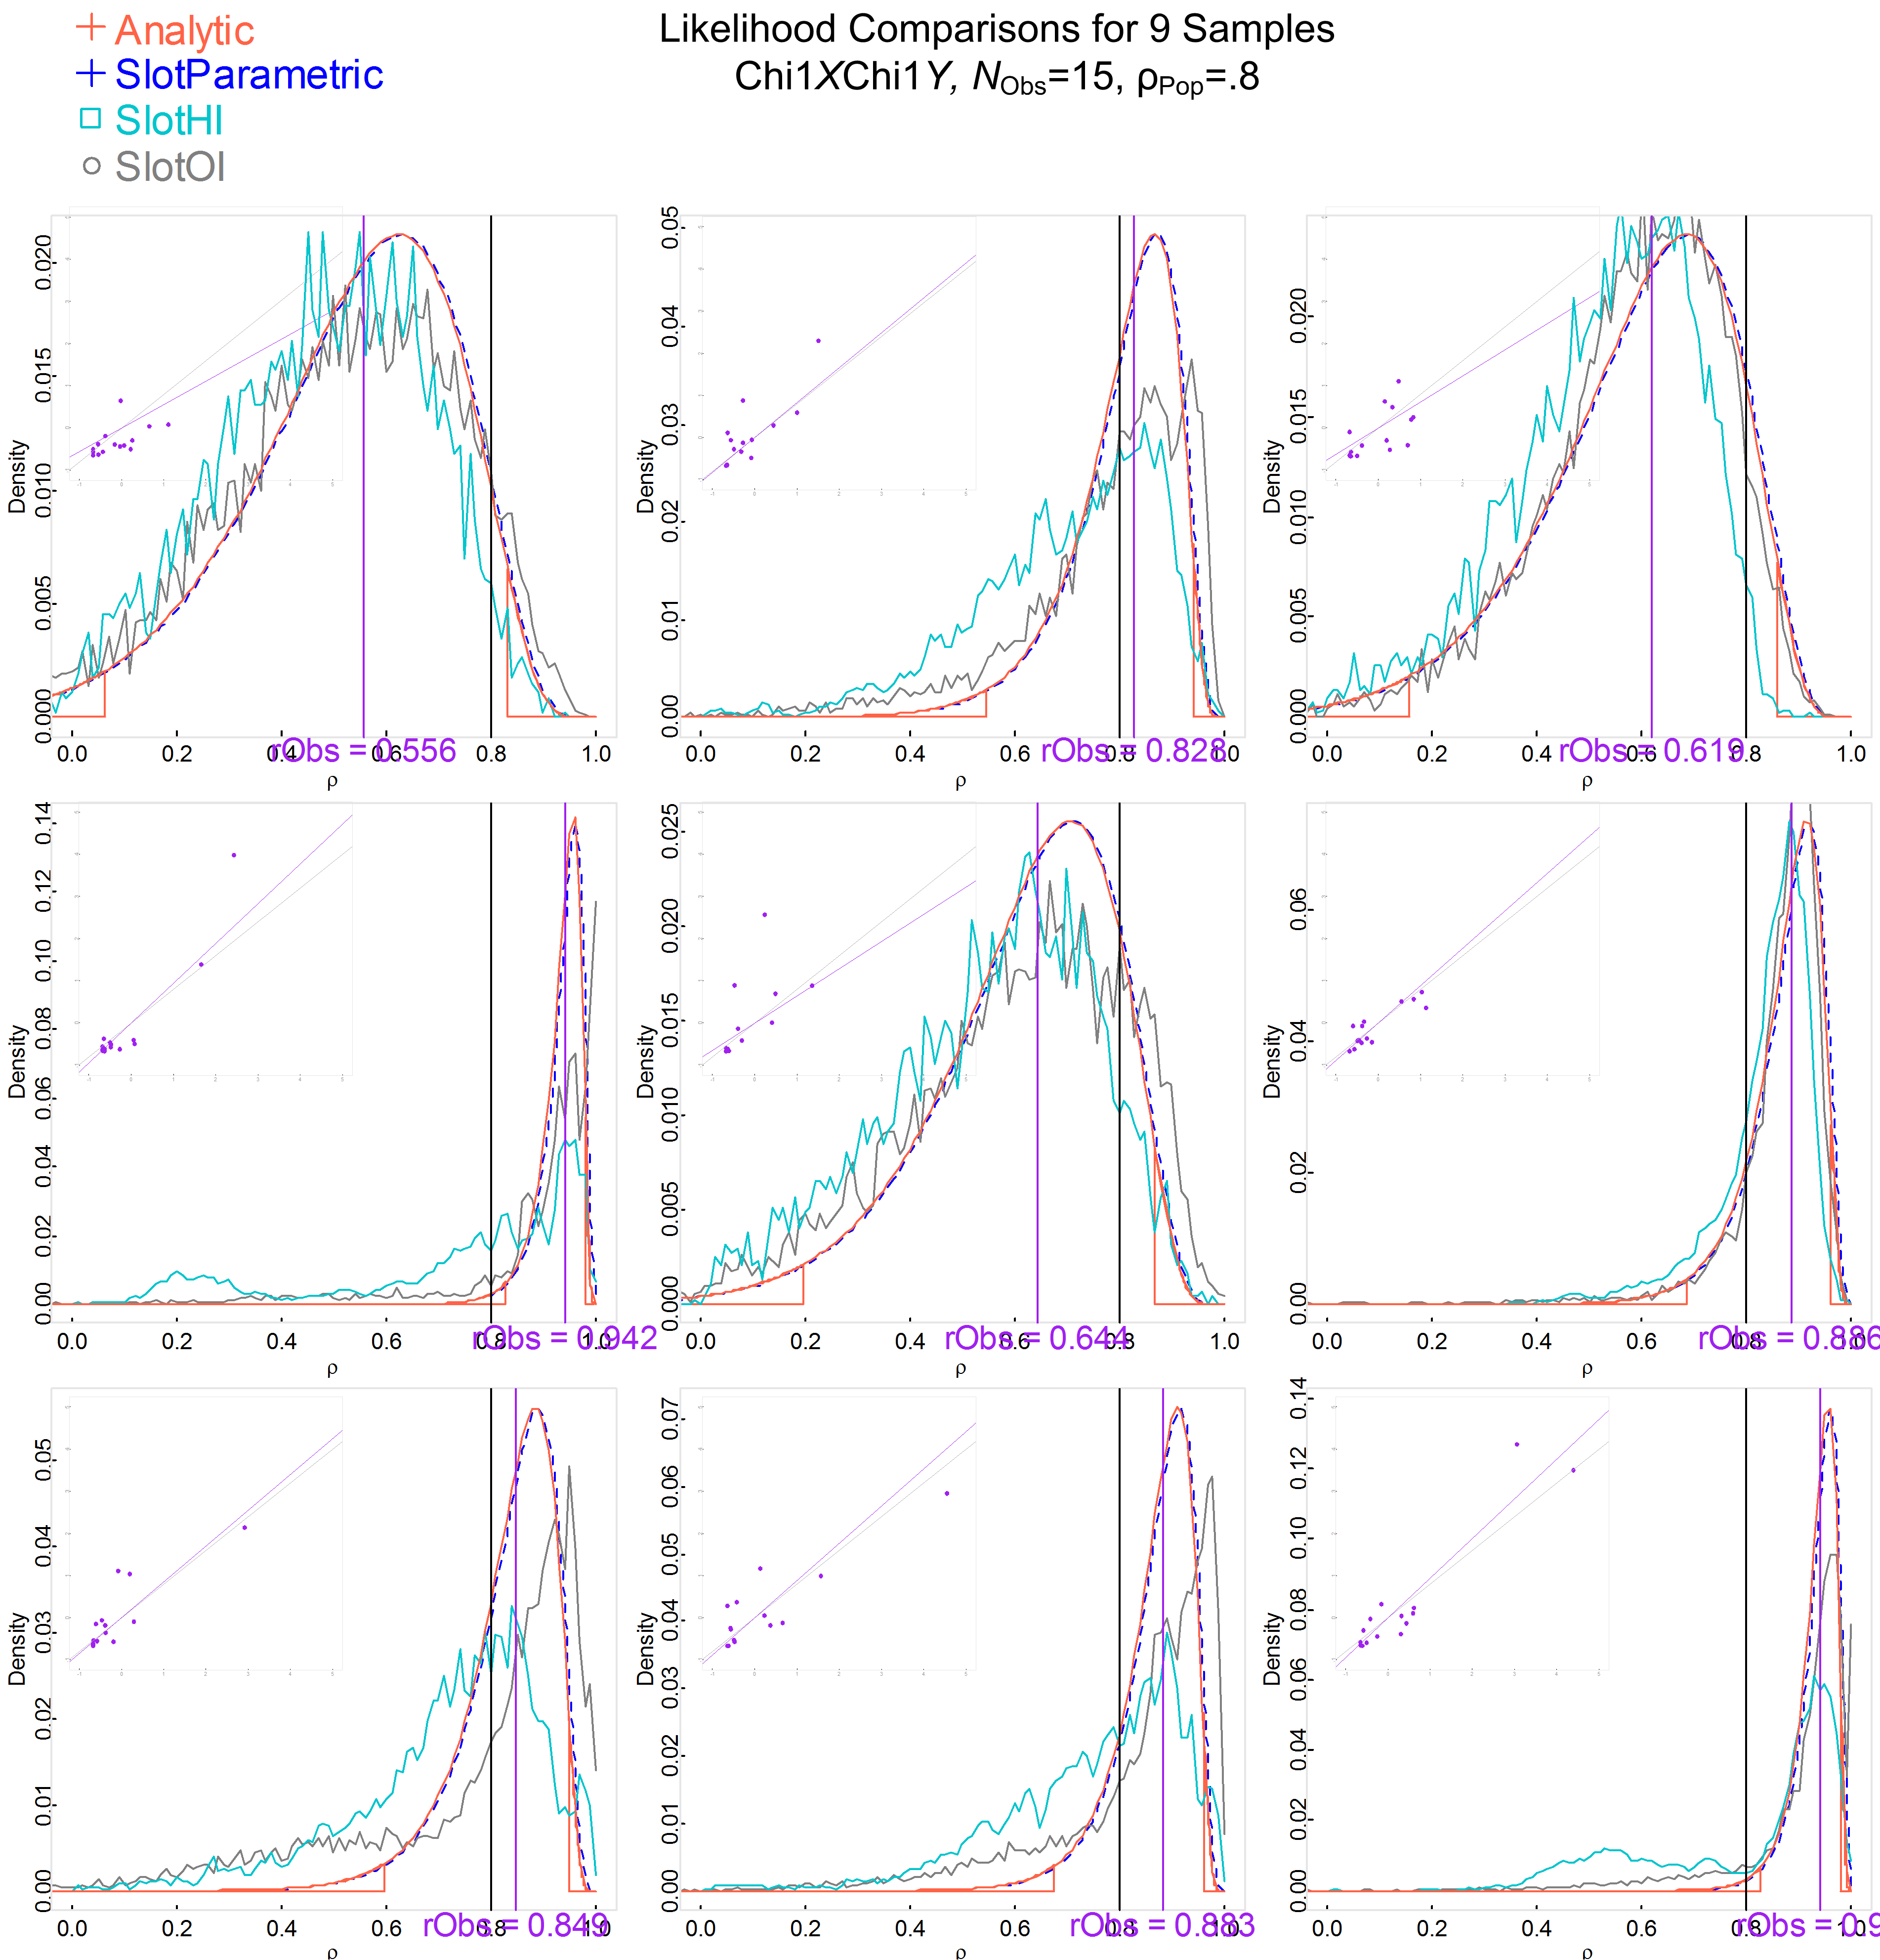

Slide 32
How was this created?
How is richness & depth added?

Slide 33
Explicit Variability
SD, SE or Hinges (parametric or bootstrap)
or Implicit Variability
Show the raw points under the fitted model
Contour lines
Use color or line type for categorical variables
Related variables over time (plotted in the background)
Threshold or other annotations

Slide 34
